Slide 1


Explore State Management - Flutter
Kamal Shree
Developer Advocate, GDE (Flutter & Dart)
India

Slide 2

Explore State Management - Flutter
Pawan Kumar
Founder Codepur, HoE Frontier and GDE
India

Slide 3
Agenda

Slide 4
Deep Dive into State Management
Simple State Management (SetState, InheritedWidget)
Other Approaches – (Bloc, Provider, etc.)
Best State Management
How to choose SM for your App
Interview Questions
Resources

Slide 5
“All views expressed in this session are my own and do not represent the opinion of any entity.”

Slide 6
Deep Dive into State Management

Slide 7

Why State Management Which is the right State Management Can I switch After Choosing One Things to remember before choosing one Should I use the latest techniques

Slide 8
Flutter is declarative

Slide 9
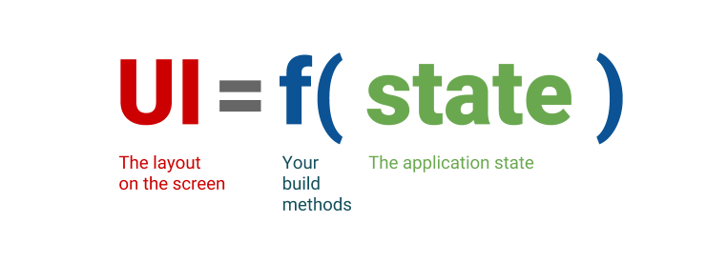

Slide 10
Ephemeral state

Slide 11




Buttons

Slide 12
App state

Slide 13
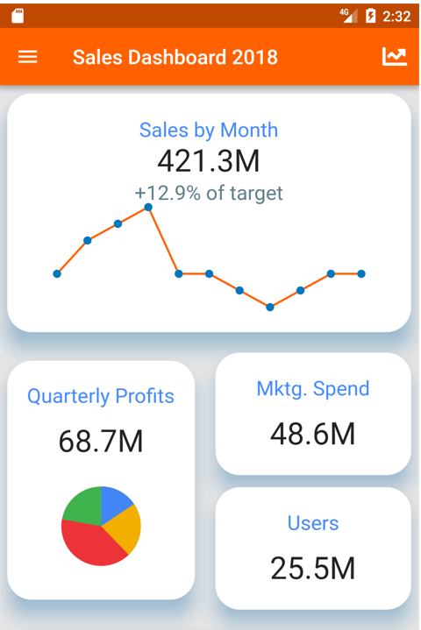


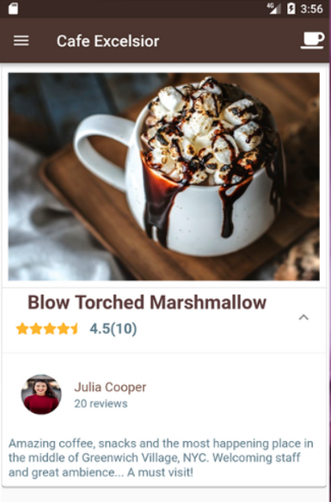

Slide 14
SetState

Slide 15
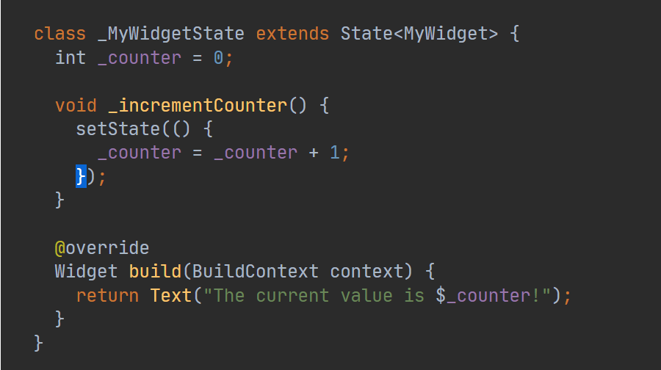

Slide 16
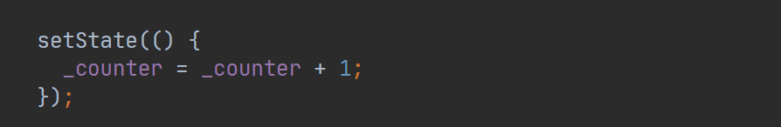
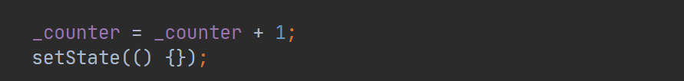
VS

Slide 17
InheritedWidget

Slide 18
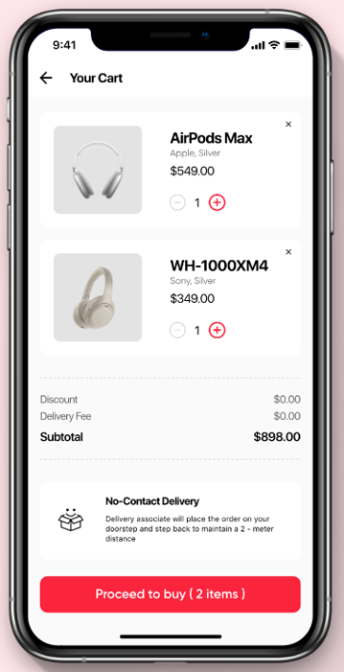
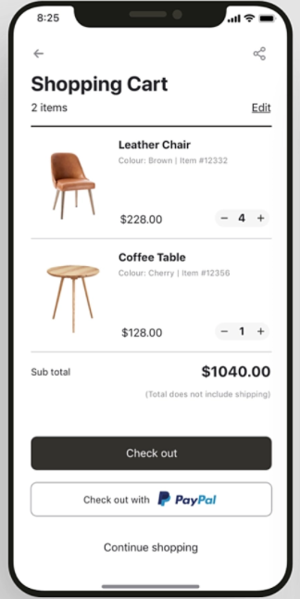
Inherited Widget
Quantity
My Items
Cart
-
Air Pod
Smartwatches
Phone

Slide 19

What is setState?

Slide 20
Calling setState notifies the framework that the internal state of this object has changed in a way that might impact the user interface in this subtree, which causes the framework to schedule a build for this State object.

Slide 21
What is State Management?

Slide 22
Data that changes over the lifecycle of the app.
State management is the place to perform logic based on UI events and then update the app state.
Notes:
When I talk about the state, I just mean the parts of your app that can vary.

Slide 23
What are different types of State Management?

Slide 24
Riverpod
MobX
GetX
setState
GetIt
States_rebuilder
Inherited Widget
Redux
Triple Pattern
Binder
Bloc/Rx
Fish-Redux

Slide 25
Resources

Slide 26
https://flutter.dev/
https://medium.com/flutter
https://www.youtube.com/c/flutterdev/videos

Slide 27



Thank You
Kamal Shree
Developer Advocate, GDE (Flutter & Dart)
Whatsupcoders
India

